Slide 1
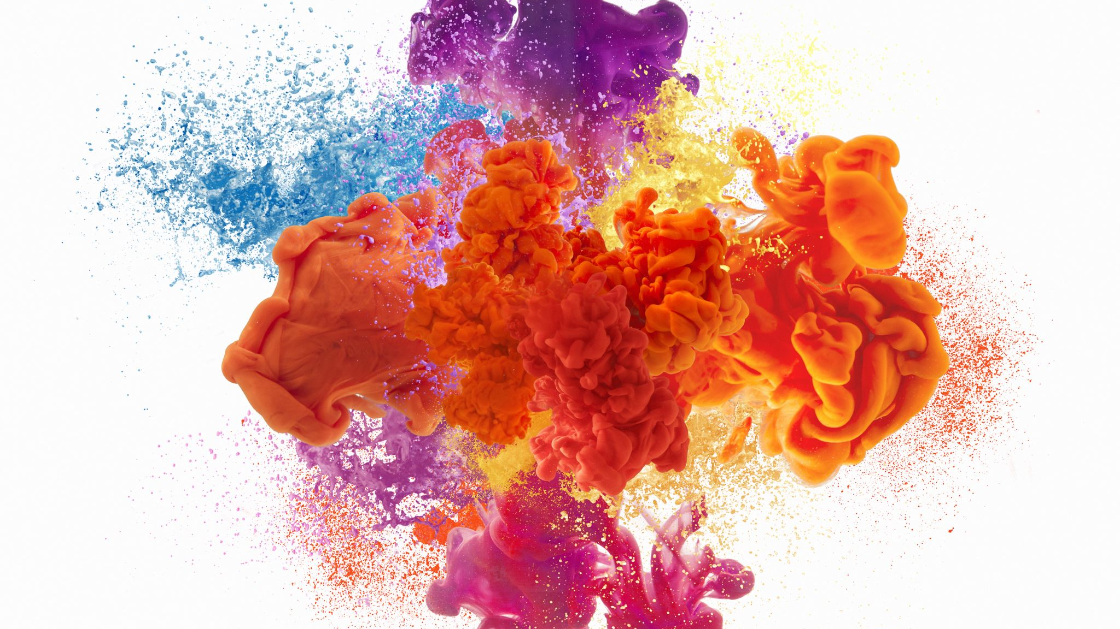

Annual Housing Rehabilitation Program Applicant Workshop
City of Palm Coast
Community Development Block Grant (CDBG)

Slide 2


CDBG Entitlement Program Overview
Federal Program that provides annual grants to local government and States started in 1974 to provide a wide range of community development and housing needs.
The City of Palm Coast component of CDBG provides qualified families and individuals with rehabilitation and repairs to correct code, health and safety code deficiencies by giving homeowners the opportunity to apply for a Forgivable Mortgage Loan.

Slide 3

City of Palm Coast Partnerships
Mid Florida Housing Partnership
Guardian
Community Resource
Management
Housing and Urban Development
Qualified Applicants
Licensed Contractors
Flagler County Housing Services

Slide 4

Basic Eligibility Requirements
1st
Home must be a Single-Family Home located within incorporated City limits of Palm Coast.
2nd
Homes must be free of delinquent liens as indicated by the Title Search other than conventional mortgages.
3rd
Home must be primary residence and owner occupied for one year prior to application.

Slide 5

Income Qualification Limits
Family or Individual must be income qualified through a completed application and fall within the current HUD FFY income allowable limits.
Assistance to households/buyers with incomes at or below 80% of the Area Median Income/AMI (LMI) (Very Low, Low to Moderate income).
Household Incomes are increased yearly and represent a household by number of people residing in home from 1-8 persons.
You can review income limits at HUD website https://www.huduser.gov/Portal/datasets/il.html or City of Palm Coast website under https://www.palmcoast.gov/housing-programs/cdbg-form.

Slide 6
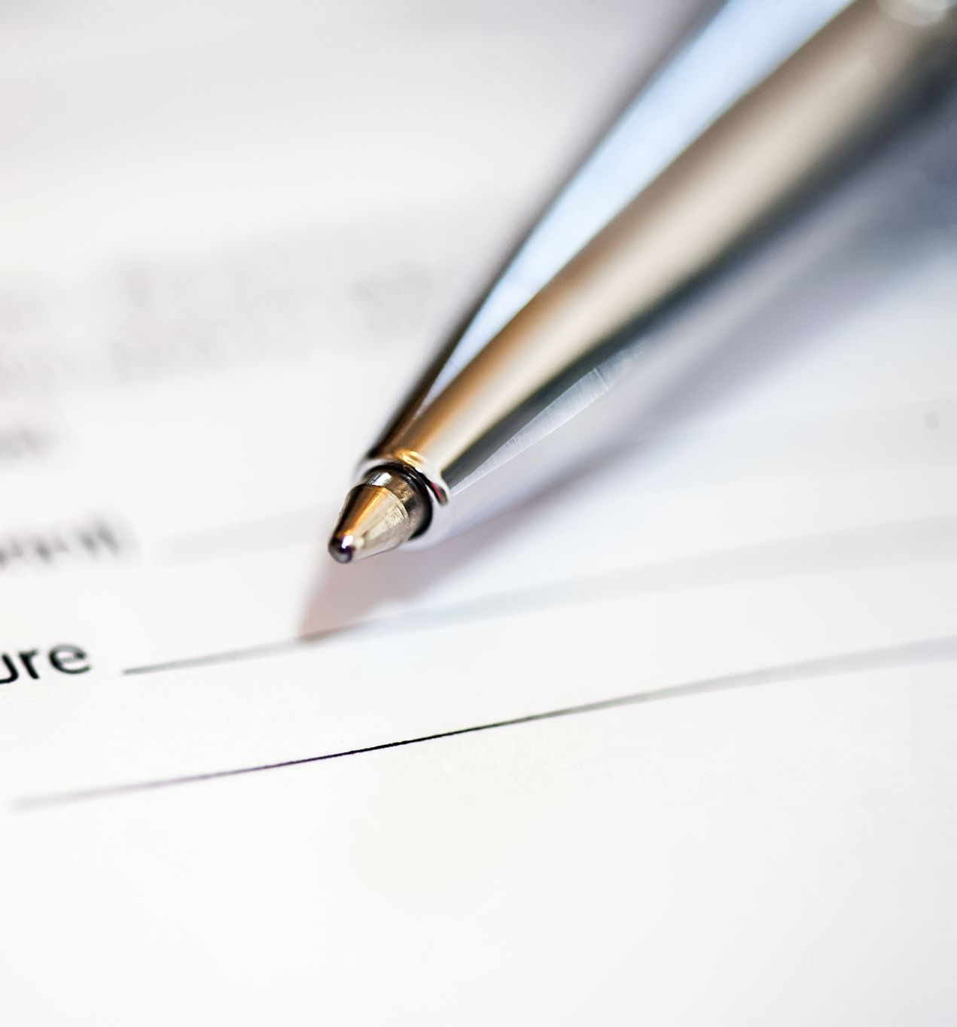
Income Qualification Timeline
New Online Application Submittal Process!!
Application intake starts December 1
Application deadline is 4 pm on December 20
Streamline document submittal processes.
Applications and documentation accepted via online portal, email , mail or fax are date/ time stamped for compliance with the application period.
In person appointments is required to be scheduled with income qualifier.
No applications will be accepted at COPC Offices by staff.

Slide 7
Eligible Rehabilitation Activities
Code Violations:
Items which do not meet current housing codes. These include primary electrical services and wiring, plumbing and structural defects.
Health & Safety:
Items which endanger health and safety such as roofing, and Mechanical Equipment.
General Property Improvements:
These are the items that make a house look nicer, feel more comfortable, and in some cases contribute to the neighborhood morale.
Funding for general improvements is limited and based on availability.
Disability Accessibility:
If you have a disability, ramps, grab bars and door widening may be included.

Slide 8
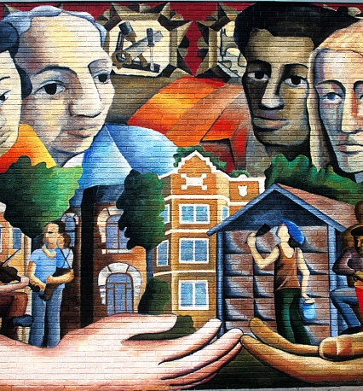
Commitment to Fair Housing
It is illegal to discriminate based on the race, color, religion, sex, National origin, age, disability, or familial status when renting, selling or financing a home or property.
You Have Rights!!
If you feel you have been discriminated against when purchasing or renting a home, please contact:
Planning Division
Community Development Department
160 Lake Ave.
Palm Coast, FL 32164
Telephone: (386) 986-3736

