Slide 1



Annual Housing Rehabilitation Program
Applicant Workshop
City of Palm Coast
Community Development Block Grant (CDBG)

Slide 2


Housing Rehabilitation Program

Slide 3

CDBG Entitlement Program Overview
Federal Program that provides annual grants to local government and States started in 1974 to provide a wide range of community development and housing needs.
The City of Palm Coast component of CDBG provides qualified families and individuals with rehabilitation and repairs to correct code, health and safety code deficiencies by giving homeowners the opportunity to apply for a Forgivable Mortgage Loan.

Slide 4

City of Palm Coast Partnerships
Mid Florida Housing Partnership
Guardian Community Services
Housing and Urban Development
Qualified Applicants
Licensed Contractors
Flagler County Housing Services

Slide 5

Basic Eligibility Requirements
1st
Home must be a Single-Family Home located within incorporated City limits of Palm Coast.
2nd
Homes must be free of delinquent liens as indicated by the Title Search other than conventional mortgages.
3rd
Home must be primary residence and owner occupied for one year prior to application.

Slide 6

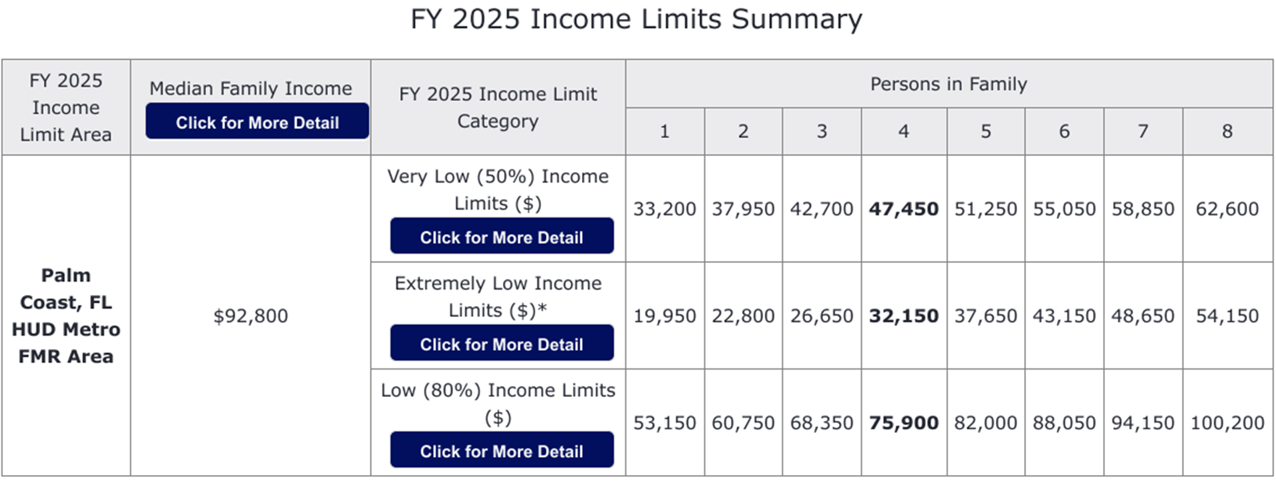
Income Qualification Limits
Family or Individual must be income qualified through a completed application and fall within the current HUD FFY income allowable limits.
Assistance to households/buyers with incomes at or below 80% of the Area Median Income/AMI (LMI) (Very Low, Low to Moderate income)

Slide 7

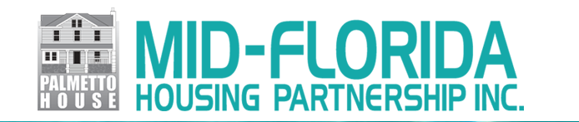
Application Documentation Requirements
Application Documentation Requirements:
Completed Application
Government Photo ID for All Applicants
Recorded Copy of Deed
Current Property Tax Receipt
Current Year’s Tax Returns and W2’s
Last 2 Paycheck Stubs for each working member of household
Current Social Security Statement of Benefits for each household member

Slide 8
Application Documentation Requirements
Documentation on Dependents claimed (including Birth Certificate, school records, court-ordered letter of guardianship, divorce decree, SSI Cards and/ or letter of adoption).
A current bank statement for all open checking, savings or other interest-bearing accounts at the time of application and at contract signing.
Third Party contact information or release to obtain third party verification of employment signed by employer and notarized. This Document must be received for eligibility determination.
Other information as applicable, self employment etc.

Slide 9




Applicant Selection & Funding
!!!!! Funding Is Limited !!!!
First Qualified and Approved, First Funded.
List of eligible applicants will be posted on the website and at City Hall.
An eligibility Letter will be sent.
If funds for this program cycle are unavailable, then your options are:
  Apply for Flagler County Ship Funds
  Apply State or Federal Programs (PACE or USDA Rural Housing Program)
  Housing Specialist about other programs
  Apply for program the next year

Slide 10

Housing Rehabilitation Program
This is not a Grant or Gift !!
It is a Deferred Payment Loan(DPL).
If you sell the property within ten years, you will pay back all or a portion of the loan depending how long the property is lived in.

Slide 11

Eligible Rehabilitation Activities
Code Violations:
Items which do not meet current housing codes. These include primary electrical services and wiring, plumbing and structural defects.
Health & Safety:
Items which endanger health and safety such as roofing, and Mechanical Equipment.
General Property Improvements:
These are the items that make a house look nicer, feel more comfortable, and in some cases contribute to the neighborhood morale.
Funding for general improvements is limited and based on availability.
Disability Accessibility:
If you have a disability, ramps, grab bars and door widening may be included.

Slide 12
Guardian Community Services Pre-bid
The City’s rehabilitation consultant conducts the property inspection (Determine rehabilitation needs and cost feasibility).
The approved Scope of Work will be developed based on needs and program guidelines.
Once accepted the Scope of Work is put out to bid by the City’s Purchasing Department.
Bids are electronically submitted by State Licensed Contractors.
City will review all bids and award the lowest responsible bid in accordance with City guidelines and acceptance by the applicant
After the bids are awarded, the Contract and Mortgage signing dates and time will be scheduled with the homeowner to take place at City Hall.

Slide 13
Construction Rehabilitation Work and Funding
Construction and Contractor Payment
Construction Length and Warranty
Contractor Payment
45 days for rehab and 120 days for replacement work performed.
All work requiring building permits will be inspected by a City building Inspector as well as the oversight inspector.
All work has a 1-year Contractor to Owner warranty for all workmanship and new materials. Roof has a 5 Year warranty plus any manufacture warranties as applicable.
Contractor payments are issued by draws based on the portion of the Scope of Work that has been completed.
Contractor draw payments must be signed off by homeowner, Guardian, and City of Palm Coast representative.

Slide 14
Commitment to Fair Housing
It is illegal to discriminate based on the race, color, religion, sex, National origin, age, disability, or familial status when renting, selling or financing a home or property.
You Have Rights!!
If you feel you have been discriminated against when purchasing or renting a home, please contact:
Planning Division
Community Development Department
160 Lake Ave.
Palm Coast, FL 32164
Telephone: (386) 986-3736

Slide 15

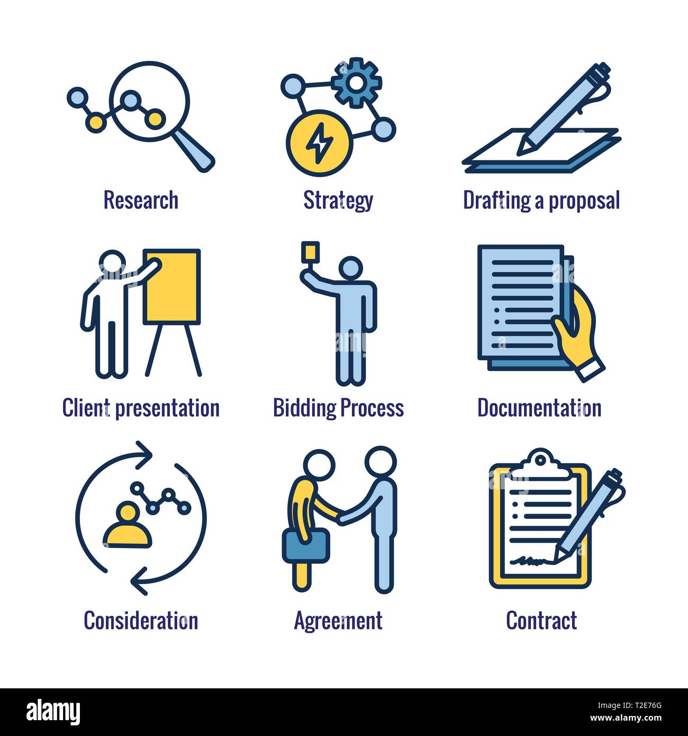

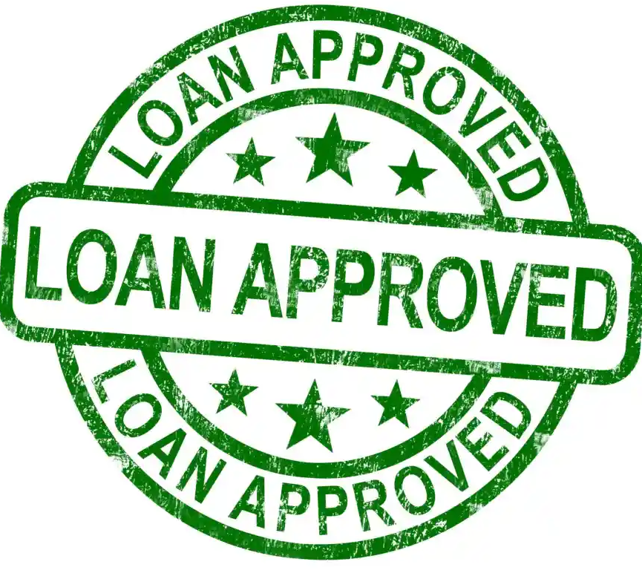
CDBG Housing Rehab Questions?
Bid Process and Construction Contracts

Slide 16
If you have additional questions, feel free to contact the following:
CDBG Housing Rehabilitation Program – Jacqueline Gonzalez, Site Development Coordinator,
City of Palm Coast at (386)986-3736 jgonzalez@palmcoastgov.com
Flagler County Housing Services (SHIP Program)- Administrative Assistant 386-586-2324 ext. 3622
https://www.flaglercounty.gov/departments/social-services/state-housing-initiatives-partnerships-ship/flagler-ship-programs
Income Qualification and Approval - contact Lydia Gregg,
Mid Florida Housing at 386-274-4441 x304 lgregg_mfhp@mfhp.org
Construction Contract Oversight - Antonio Jenkins, Guardian Community Services at 863-899-6695 antonio.jenkins@guardiancrm.com
t
Thank you for coming

Slide 17
Income Qualification Verified by Application Completion
Obtain an application at workshop, online, or City Hall. New Online Submittal!!
You may contact Jacqueline Gonzalez at 386-986-3736 with any additional questions.
Application intake starts December 1, 2024 .
Application deadline is 4 pm on Friday, December 20, 2024.
Applications and documentation accepted via email , mail or fax are date/ time stamped for compliance with the application period.
If in person appointments is required contact City of Palm Coast Staff to schedule.
No applications will be accepted at COPC Offices by staff.

Slide 18
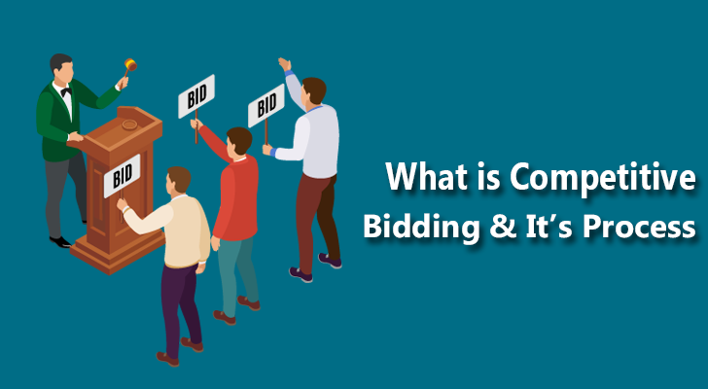

Guardian Community Services
City Bid Process, Bid Award, and Contract signing
City Bid Process
  Bids are electronically submitted by State Licensed Contractors.
  City will review all bids and award the lowest responsible bid in accordance with City guidelines and acceptance by the applicant.
Bid Award & Contract Signing
  After the bids are awarded, the Contract and Mortgage signing dates and time will be scheduled with the homeowner to take place at City Hall.
  All corresponding paperwork is signed this includes but not limited to Notice to Proceed, Notice of Commencement and three-day rescission form.

