Slide 1
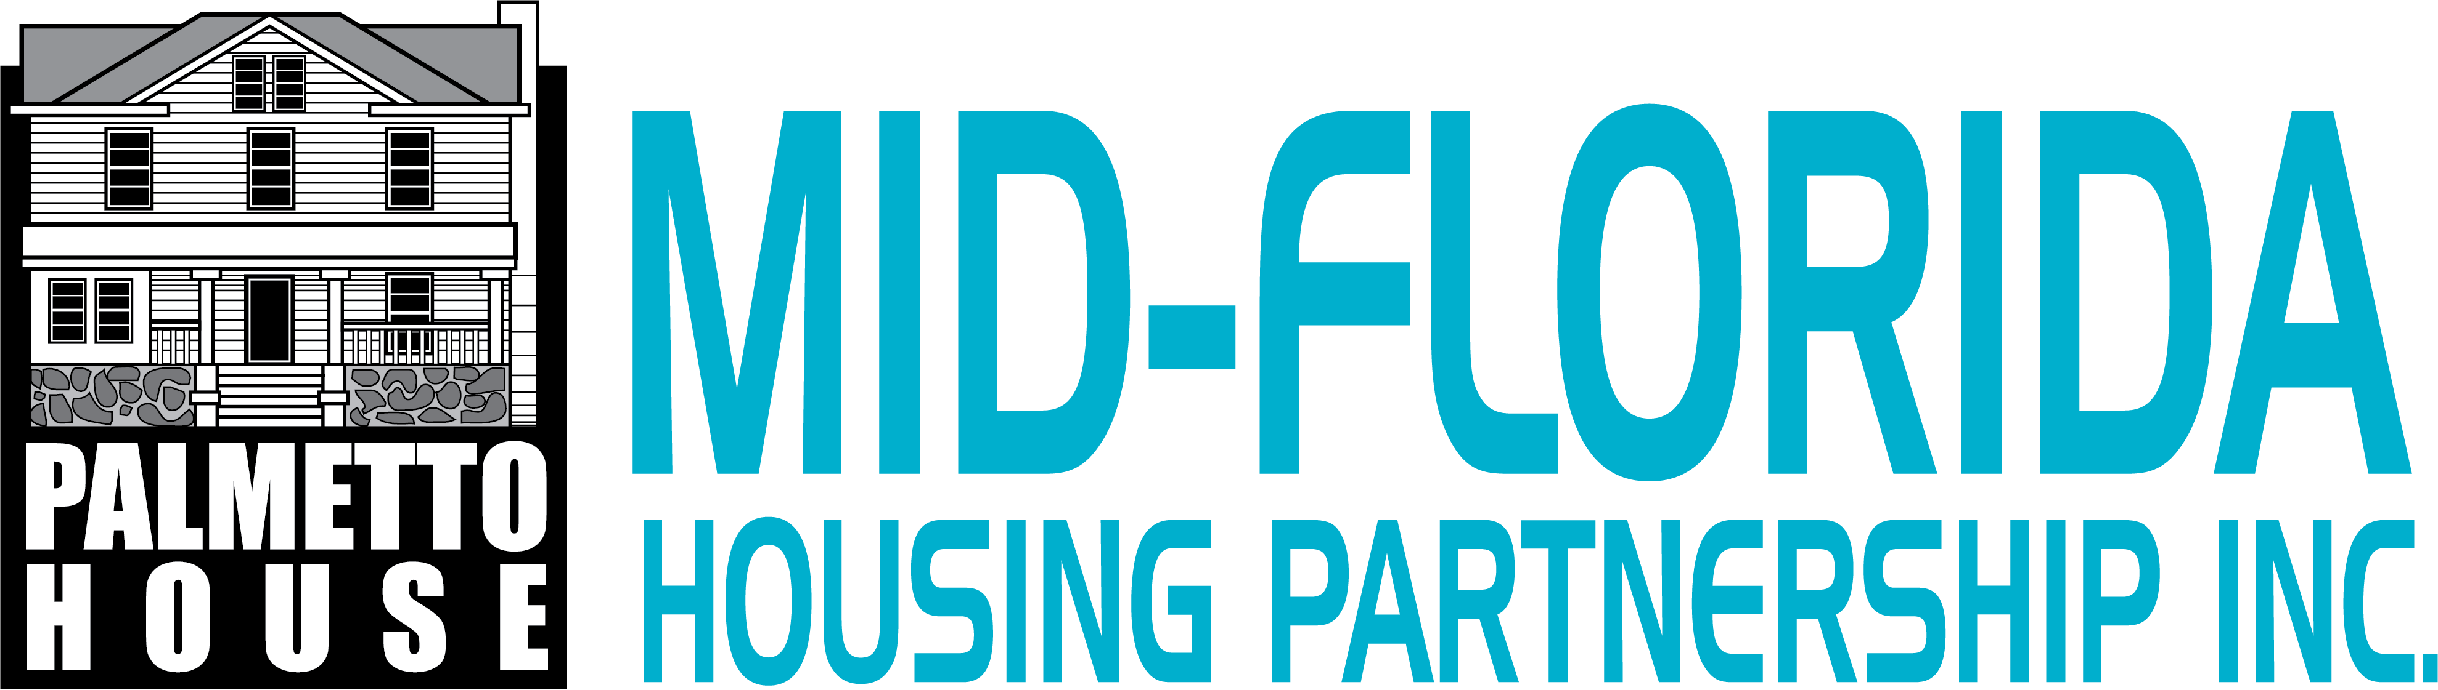
Financing Home Improvements & Repairs

Slide 2
Options for Financing Home Repairs
Self Funding
Barter System
Government Programs
Loans made for Financing

Slide 3

Self Funding
Create a Dedicated Savings Account: Start an emergency fund specifically for home maintenance and repairs, adding to it monthly.
DIY & Sweat Equity: Tackle smaller repairs yourself to save on labor costs, using saved funds for materials.
Track Home Value: Regularly assess your home's worth to understand your equity, which can be tapped for larger projects.
.
Use tax refund money.

Slide 4
Bartering system
Identify your valuable skills (like painting, plumbing, or carpentry) and find neighbors or community members needing those skills, then trade for the repairs you need

Slide 5
Government Programs
You can use government programs for home improvements through HUD loans (Title I, 203(k)), USDA rural repair grants/loans for low-income homeowners, energy tax credits (like for solar/windows), VA grants for disabled veterans, and local programs

Slide 6
Volusia County
Community Assistance implements an owner-occupied rehabilitation program that may assist eligible homeowners with necessary health and safety repairs within Volusia County's service areas. The service areas are anywhere in Volusia County, except the city limits of Daytona Beach, Deltona and Ponce Inlet.
The program is funded by Volusia County through federal and state grants and governed by guidelines and regulations as set forth in the Affordable Housing Program Policy (AHPP). Funds are provided to eligible households with a zero interest, deferred loan or repayment loan (in very limited circumstances funds are provided as a grant). Eligible households will be evaluated according to the policy's underwriting standards.
Eligibility requirements
  • Applicant cannot have previously received housing assistance (owner-occupied rehabilitation or homebuyer assistance)
  • Applicant must have owned and occupied the housing unit for a minimum of one (1) year under a recorded instrument and have current homestead exemption status
  • The housing unit must be
    site built or a manufactured home located on land you own that was built after 1994.
  • Property taxes and existing mortgage(s) must be current
  • Household income cannot exceed the Area Median Income requirements below:
Household size | 1 | 2 | 3 | 4 | 5
80% AMI | $29,250 | $33,600 | $37,400 | $41,750 | $45,100
120% AMI | 43,920 | $50,160 | $56,400 | $62,640 | $67,680

Slide 7
City of Daytona Beach
Repair Program
Program Purpose
Provides assistance to low-income, owner-occupied households to correct health, safety and/or potential code enforcement violation issues.
Eligibility Requirements
The applicant must:
Own and occupy the single-family residence for which assistance is requested.
Not have the means to make the needed repairs (assets, property, insurance, etc.).
The city must determine that the assistance is needed.
The applicant's gross annual household income must not exceed the current HUD income limits.
Reconstruction Program
Program Purpose
This program provides assistance to low-income, owner-occupied households for substantial housing rehabilitation or reconstruction of a unit which is not feasible for standard repairs.
Eligibility Requirements
The applicant must:
Own and occupy the single-family residence for which assistance is requested.
Not have the means to make the needed repairs (assets, property, insurance, etc.).
Not have excessive property encumbrances for rehabilitation and no encumbrances for reconstruction.
The city must determine that the housing unit is substandard.
The property must be brought up to applicable codes.
The applicant's gross annual household income must not exceed the current HUD income limits

Slide 8
Flagler County
Flagler County Housing Services administers programs that help preserve the safety, stability, and longevity of owner-occupied homes. These are not emergency repairs. Applications are accepted online year-round and prioritized by income and documented special needs.
Preservation-focused: scopes aim to extend the useful life of the home and reduce future risk. Not a renovation wish list and not immediate assistance.
Eligibility Requirements
You must own and occupy the home as your primary residence and maintain a homestead exemption.
Mobile/manufactured homes must be built after 2007 and located on land you own.
There is currently a wait list for assistance.
Income Eligibility
Programs serve households up to 80% AMI, with priority for households at 50% AMI and below. Income limits are updated annually.

Slide 9
City of Palm Coast
The Community Development Block Grant (CDBG) program is administered nationally by the U. S. Department of Housing and Urban Development (HUD). Funding is provided annually to cities and counties for activities designed to address the objectives of the program to provide decent and safe housing, a suitable living environment, and expanding economic opportunities.
Beneficiaries of the program must be low and moderate income households (defined as a family whose annual income does not exceed 80% of the area median income).

Slide 10

Financing Home Improvements with Loans
Understanding HELOCs, Home Improvement Loans, and HEIs

Slide 11
What is a HELOC?
• Home Equity Line of Credit
• Revolving credit based on home equity
• Variable interest rate
• Use funds as needed during draw period

Slide 12
Pros & Cons of a HELOC
Pros:
• Flexible access to funds
• Often lower interest rates
Cons:
• Variable rates
• Your home is collateral

Slide 13
What is a Home Improvement Loan?
• Fixed-term installment loan
• Lump sum paid upfront
• Fixed interest rate
• Often unsecured

Slide 14
Pros & Cons of Home Improvement Loans
Pros:
• Predictable payments
• No home equity required
Cons:
• Higher interest rates
• Less flexibility

Slide 15
What is an HEI?
• Home Equity Investment
• Investor provides cash in exchange for future home value share
• No monthly payments
• Repaid when home is sold or term ends

Slide 16
Pros & Cons of HEIs
Pros:
• No monthly payments
• No interest charges
Cons:
• Share future appreciation
• Complex terms

Slide 17
Comparing the Options
Best
HELOC: Best for ongoing projects
Home
Home Improvement Loan: Best for one-time projects
Best
HEI: Best for payment flexibility

Slide 18

Which Option is Right for You?
Consider:
• Project size
• Cash flow
• Risk tolerance
• Long-term plans

