Slide 1

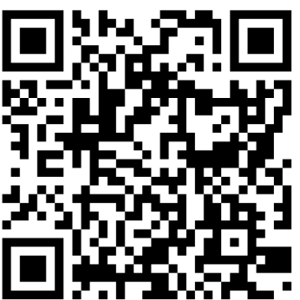
City of Palm Coast Building Permitting Inspection Request App
https://cdpservices.palmcoast.gov/inspect_prod/

Slide 2
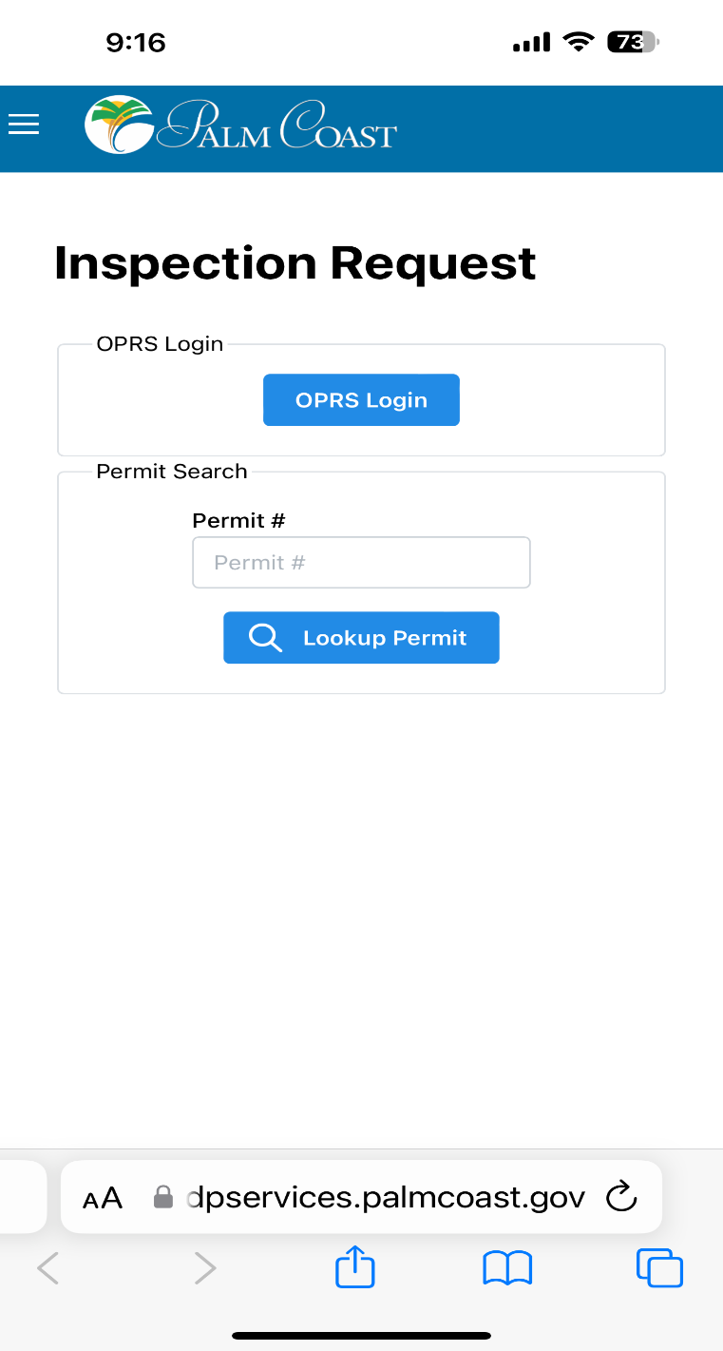
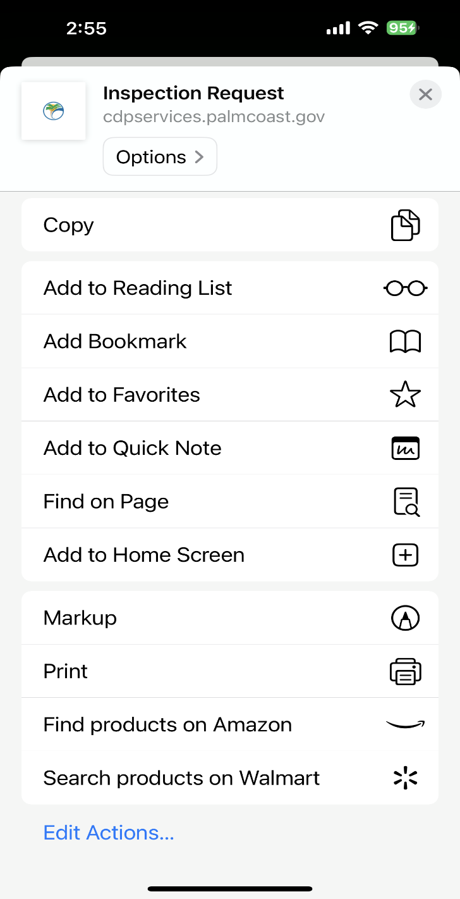
https://cdpservices.palmcoast.gov/inspect_prod/ To access all permits and use enhanced functionality, you will need a OPRS (online permit request system) login linked to the contractor. This login will allow you save multiple favorites to provide for easy access to your specific projects. To do this, you will need to go to the online permitting portal and follow the directions to create an account in the ‘how to use the online portal guide’
To create a shortcut/app on your phone, click the Box with the up arrow and choose
Log in OR use a permit # to search

Slide 3
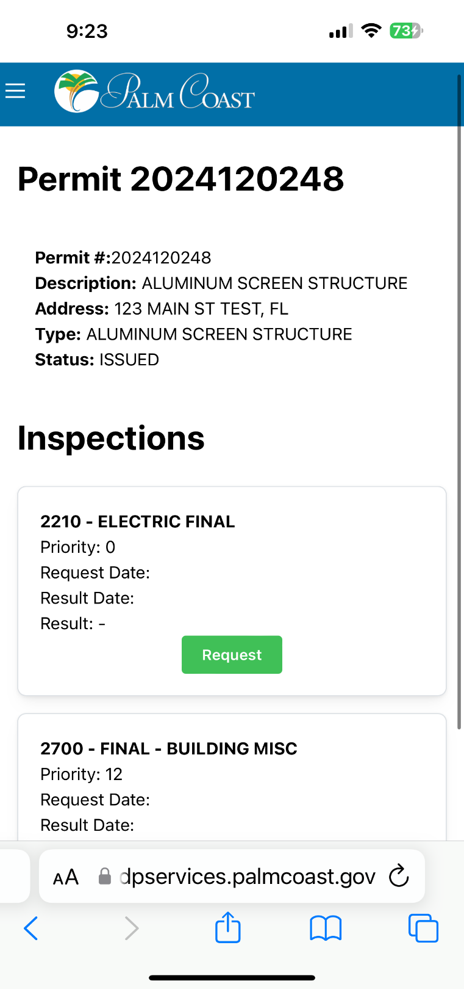
Using a permit # will take you directly to that permit for scheduling.

Slide 4
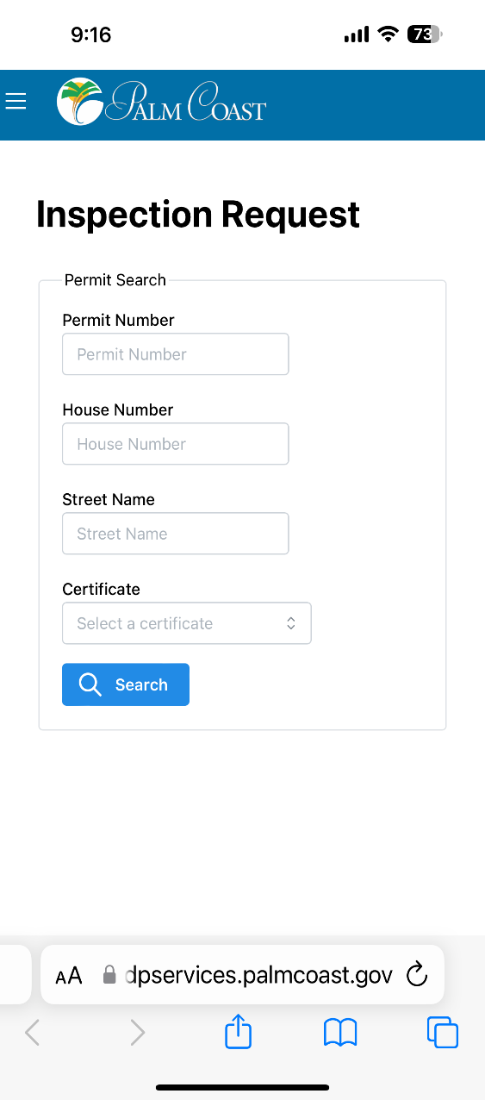
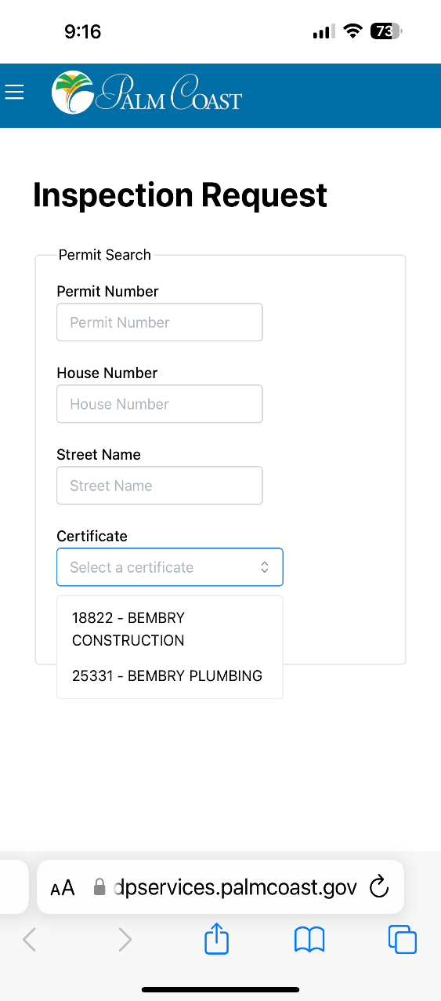
Using your OPRS login will allow you to choose your certificate (contractor) linked to your login.
You may also search by permit # or address

Slide 5
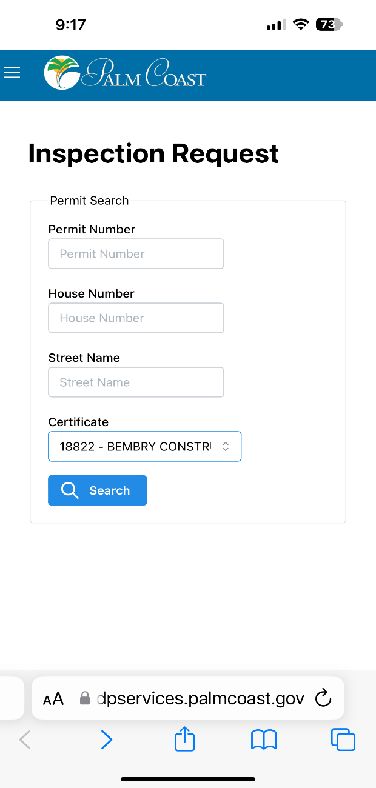
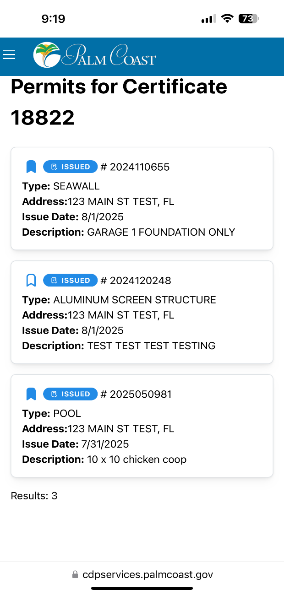
Choose the certificate and click search
A list of permits associated with the contractor license you chose will appear.
**Highlighting the bookmark icon will add them to your list of favorites for quick access and filter your specific projects.
Click the permit you want to schedule the inspection for.

Slide 6
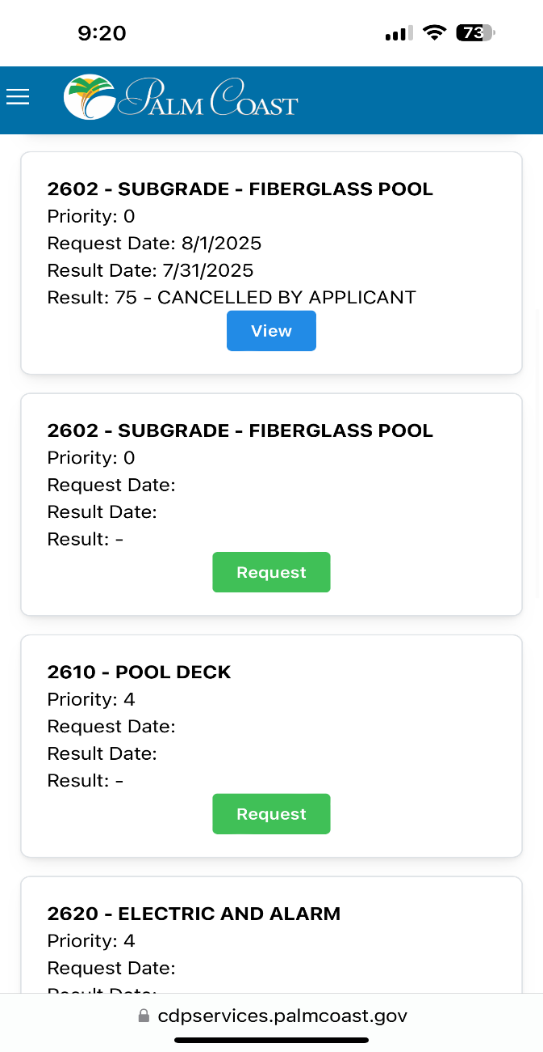
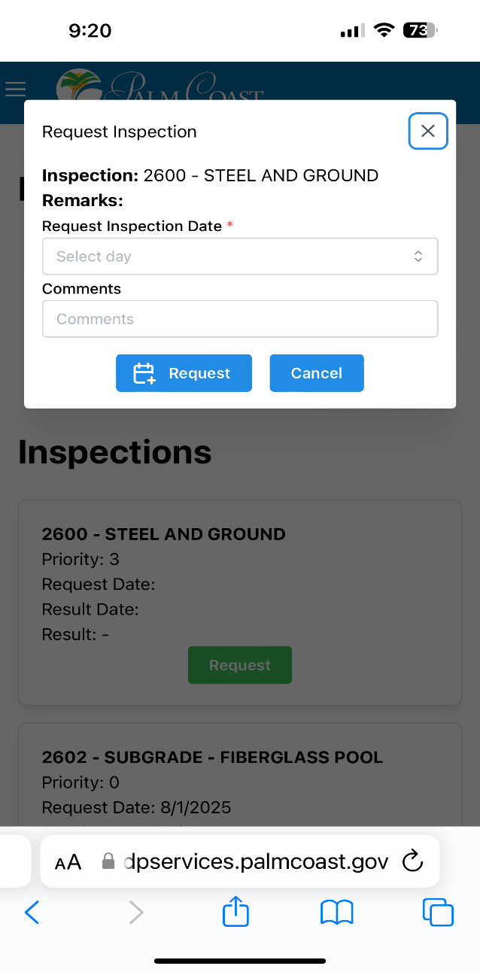
Scroll to find your inspection.
Click request

Slide 7
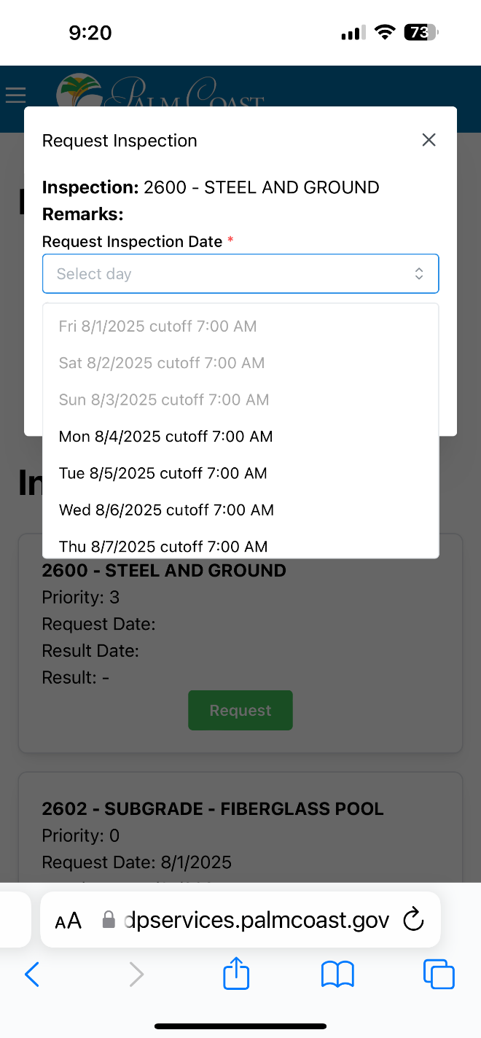
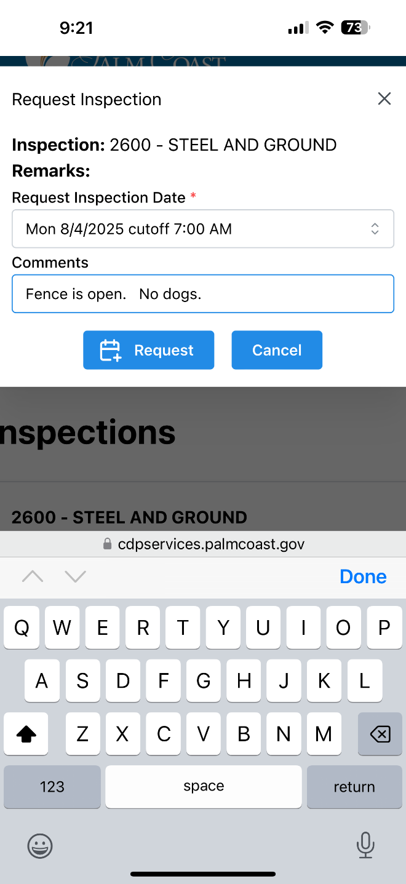
Choose the inspection date
Add any applicable comments
Click request
Time requests are not available, please contact the assigned inspector after receiving the notification email the morning of your inspection to determine a 2 hour time frame.

Slide 8
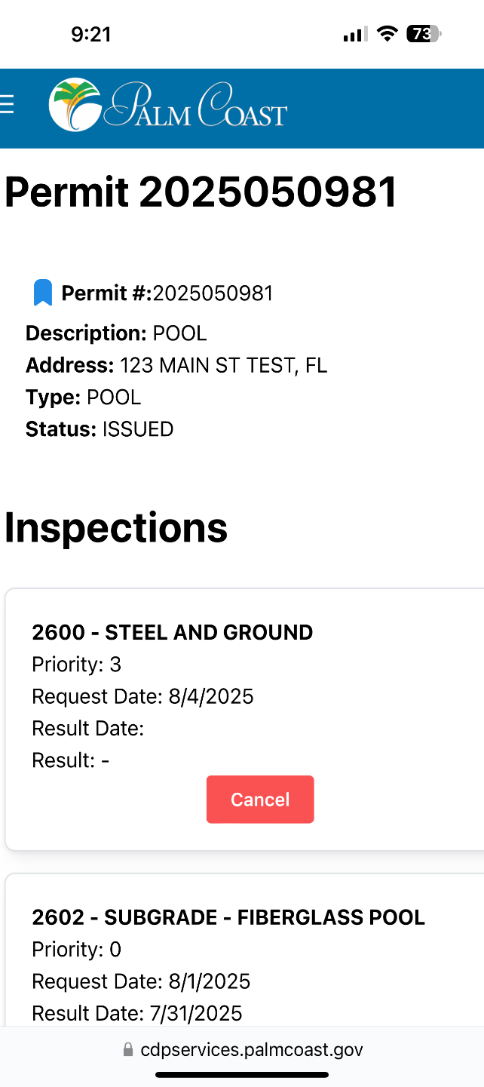
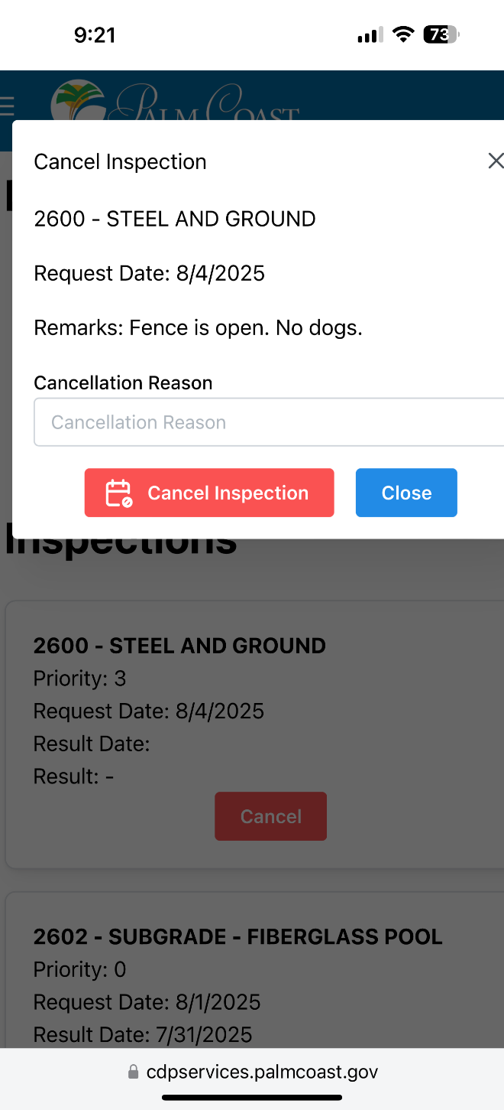
You will now see your inspection has been requested
To cancel the inspection, click the cancel button

Slide 9
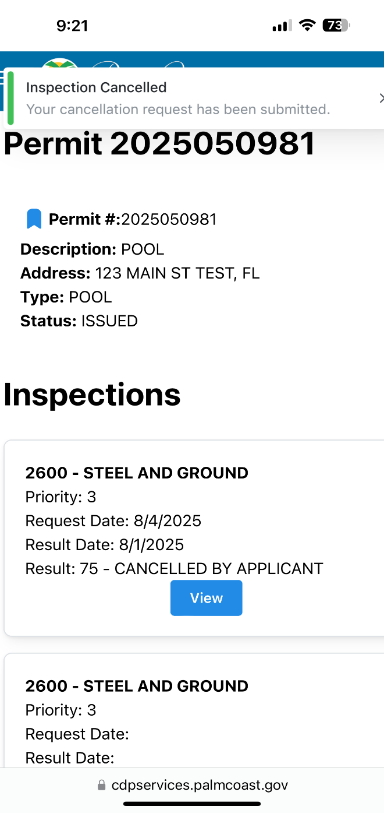
Confirmation will appear at the top of the screen
The status of that inspection will now be ‘view’ (indicating action was taken on that inspection)
A new inspection will appear with the option for scheduling when you are ready

Slide 10
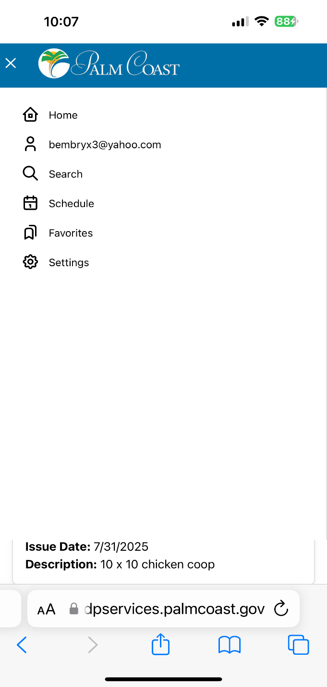
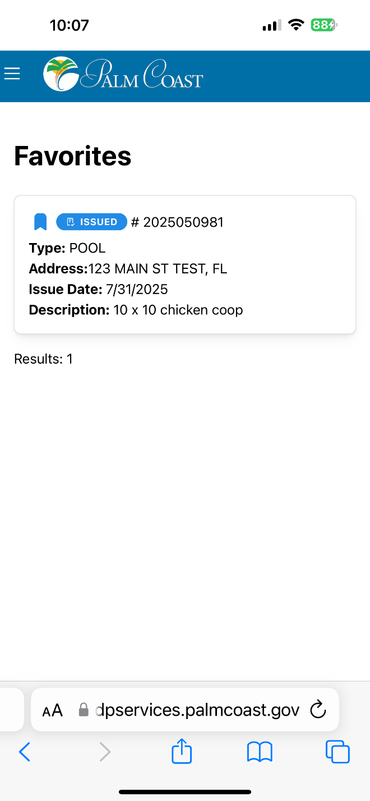
Using your OPRS login, you will have the option to choose from favorites and scheduled inspections.
Favorites will provide a list of only those permits you have bookmarked. This is a great tool for a contractor with multiple project managers who need to filter out their projects.

